Slide 1

Estimands GMDS Summer Academy 2024 and EFSPI 9th RegStat
Zehui Bai
Senior Biostatistician II
XXX-XXX-2024

Slide 2
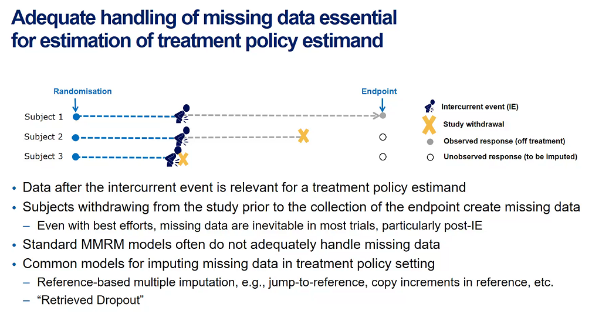
Estimation methods for estimands using the treatment policy strategy EFSPI 9th RegStat -- Short Topic 2
Handling missing data in clinical trials is a critical issue, particularly when endpoints are not observed due to subjects dropping out or other intercurrent events (IE). Addressing this missing data appropriately is essential to ensure reliable and accurate estimation of treatment effects.
Missing Endpoint Data: When subjects leave a study prematurely, the intended endpoints are not observed, leading to missing data. This situation compromises the integrity of the statistical analysis and the conclusions that can be drawn about a treatment’s effectiveness.
Importance of Appropriate Handling: Properly managing missing data is vital to avoid bias and to accurately estimate treatment policy effects.
https://efspieurope.github.io/workshop/data/2024/slides/s2_Muetze.pdf
Common Approaches to Handling Missing Data
Standard Methods:
These often do not adequately address the missing data problem, potentially leading to biased estimates.
Advanced Imputation Techniques:
Reference-Based Imputation: Techniques like “jump to reference” or “copy reference increments” assume that missing data after an IE can be approximated by observed data from a reference group. These methods require clear justification of the clinical assumptions made.
Retrieved Dropout Models: These models assume that missing data post-IE are similar to the observed data post-IE within the same study arm. They typically exhibit less bias in scenarios where the assumptions match reality.

Slide 3
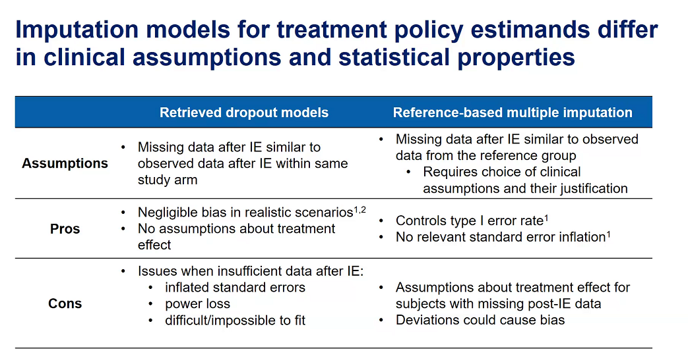
Estimation methods for estimands using the treatment policy strategy EFSPI 9th RegStat -- Short Topic 2
Notes:
Imputation Models Described: 1. Retrieved Dropout Models: - Assumptions: These models assume that missing data after an intercurrent event are similar to the observed data after such events within the same study arm. - Pros: - Minimal bias in realistic scenarios where assumptions hold. - No assumptions are made about the treatment effect beyond what’s observed. - Cons: - These models can have inflated standard errors and result in power loss when there is insufficient data post-IE. - They can be difficult or impossible to fit effectively if the data are sparse.
Reference-Based Multiple Imputation:
Assumptions: This approach assumes that missing data post-IE should be similar to observed data from a reference group, requiring explicit clinical assumptions and justification.
Pros:
Helps control the Type I error rate and avoids inflating the standard error.
Cons:
Assumes a particular treatment effect for subjects with missing post-IE data, which can introduce bias if these assumptions deviate from the true scenario.

Slide 4
Estimation methods for estimands using the treatment policy strategy EFSPI 9th RegStat -- Short Topic 2
Question 1: “When estimating a (primary) estimand that adopts a treatment policy strategy, would regulators accept an analysis approach that imputes the missing values using a reference-based imputation method if the assumptions of the imputation approach can be clinically justified?”
Key Considerations:
Regulatory Perspective: Regulators, like the FDA, generally require robust justification for any imputation technique used. The acceptability hinges on the clinical justification of the assumptions underlying the reference-based imputation method.
Clinical Justification: For a reference-based approach to be accepted, the assumptions about the similarity of missing data to the reference group must align with known clinical behaviors of the disease and treatment. It’s essential to demonstrate that the reference group is an appropriate and representative comparator.

Slide 5
Estimation methods for estimands using the treatment policy strategy EFSPI 9th RegStat -- Short Topic 2
“Question 2 If it is unclear which assumptions are appropriate for the missing data imputation, which principles should guide the selection of the imputation model, e.g., type I error rate control, conservative bias for the treatment effect estimate (i.e., underestimate the treatment effect), bias-variance trade-off, clinical plausibility?”
“What is the priority order of the listed criteria?”
“Are there other important criteria which are not listed?”
Priority Order:
Clinical Plausibility: Often considered a top priority because if the imputed data are not clinically plausible, the integrity of the entire analysis can be questioned.
Type I Error Rate Control: Critical for regulatory approval, as controlling the false positive rate ensures that findings are statistically sound.
Conservative Bias for Treatment Effect: Important in risk management, especially in clinical decisions where safety is paramount.
Bias-Variance Trade-Off: Important but often secondary to the above considerations, as a methodologically sound approach can still yield useful results even with some trade-offs in bias and variance.
Additional Criteria:
Robustness to Assumptions: The selected imputation method should be robust to variations in the underlying assumptions about the missing data.
Transparency and Reproducibility: The method should be clear and reproducible, allowing other researchers to understand and replicate the findings.

Slide 6
Whether the commonly used “treatment-policy strategy” in clinical trials truly reflects the underlying clinical question of interest EFSPI 9th RegStat S2-Talk 1
Introduction: In this strategy, the occurrence of intercurrent events (such as discontinuation of treatment or use of additional therapies) is considered irrelevant in defining the treatment effect. This approach is often based on statistical rationale rather than clinical reasoning.
Regulatory context: Regulatory advice often defaults to this strategy, where outcomes are analyzed as though the treatment continues, even after an intercurrent event. This can sometimes overlook the clinical context, focusing purely on statistical considerations.
https://efspieurope.github.io/workshop/data/2024/slides/21_Bretz.pdf
Why is the treatment-policy strategy so prevalent? Is this the best way to answer clinical questions, or does it simply reflect convenience in data handling?
When does the strategy truly align with the clinical question? Does it always serve the purpose of what the clinical trial intends to uncover about a drug or treatment’s efficacy?
The importance of bringing in different disciplines—such as statistics, clinical experts, and patient advocates—into the discussion is emphasized. This can enrich the conversation and help ensure that the trial design and strategies used are both clinically relevant and statistically valid.
The broader purpose of clinical trials is questioned: What are we really trying to learn? Are we trying to learn about a drug’s effect in real-world settings (which might be aligned with a treatment-policy strategy), or are we more interested in understanding the precise biological effect of the drug itself, separated from intercurrent events?

Slide 7
Whether the commonly used “treatment-policy strategy” in clinical trials truly reflects the underlying clinical question of interest EFSPI 9th RegStat S2-Talk 1
Changes in Control and Treatment Lines:
In oncology trials, the evolution of standard treatments complicates comparisons over time. For instance, a new drug might be tested as third-line therapy initially and later as second-line therapy, leading to complex interpretations when comparing different treatment strategies.
Clearly document the evolution of treatment lines and apply statistical methods that account for changes over time.
Crossover of Treatment Strategies:
Control group patients may switch to the experimental treatment due to disease progression, creating a mix of treatment sequences that complicates efficacy evaluation.
Use statistical models designed to handle crossover events or consider the use of time-to-event analysis methods to account for treatment switches.
Treatment-policy strategy can be challenging to interpret
Maintaining a consistent control strategy can be difficult as standard treatments evolve. Changes in control strategies can make initial estimations of treatment effects less reliable by the trial's end.
Ensure pre-specified endpoints and account for control group changes in the analysis to support consistency in interpretation.
Engage with regulatory agencies to determine acceptable adaptations that reflect clinical practice changes, balancing consistency and relevance.
Notes:
一种新药可能最初被作为 三线治疗药物进行测试（在其他治疗药物失败后），然后被提升为 二线治疗药物进行测试。治疗线的这种变化可能导致在不同时间点对不同的治疗政策（策略）进行比较，这变得难以解释
In the context of Changes in Control and Treatment Lines and Crossover of Treatment Strategies, the treatment-policy strategy typically refers to the approach where the effect of the initial, assigned treatment is estimated regardless of any subsequent changes in the treatment or control conditions. This strategy follows an "intention-to-treat" (ITT) principle, where all participants are analyzed according to the treatment they were originally assigned, irrespective of any treatment adjustments during the trial.
Changes in Control and Treatment Lines:
Here, the treatment-policy strategy aims to maintain the interpretation of results based on the originally assigned treatment and control conditions, even when standard treatments evolve or new therapies are introduced. This means analyzing outcomes as if patients remained in the initially assigned treatment line (e.g., second-line or third-line), without considering later modifications. This strategy preserves the initial treatment assignment's relevance but can make interpretation difficult when clinical practice changes over time.
Crossover of Treatment Strategies:
For crossover cases, where participants in the control group switch to the experimental treatment or vice versa, the treatment-policy strategy would still assess outcomes based on the original treatment assignments. This approach assumes that subsequent treatment changes (like switching to the experimental group) do not affect the primary evaluation of the initially assigned treatment effect. This strategy is intended to measure the real-world effect of initiating a particular treatment, even if patients later receive additional or alternative therapies, but it can obscure the actual effect of the original treatment alone.

Slide 8
Whether the commonly used “treatment-policy strategy” in clinical trials truly reflects the underlying clinical question of interest EFSPI 9th RegStat S2-Talk 1
Complexity from Rescue Medications: The use of rescue medications during trials introduces complexity to treatment-policy evaluations, as it can obscure the true effect of the experimental drug, especially in trials with a focus on long-term outcomes.
Challenges in Assessing Rescue Medications: Treatment-policy aims to assess the overall effect, including rescue medications, which may complicate interpretation, especially when rescue use is frequent. Separating the impact of the experimental drug from rescue treatments becomes challenging in these cases.
Treatment-Policy vs. Hypothetical Strategy:
A hypothetical approach—considering outcomes without rescue medication—may provide a clearer view of the experimental drug's effect. This approach isolates the drug's impact and avoids the conservative bias of the treatment-policy approach, which includes rescue medication effects.
Conservative vs. Hypothetical Approach:
The treatment-policy approach is considered conservative, as it includes rescue effects that may mask the experimental drug’s benefit. The hypothetical approach can offer clearer insights by focusing on the drug's effect in the absence of rescue medications.

Slide 9






ICONplc.com
© 2023 ICON. All rights reserved.

